Slide 1
Use Case Documents
Dmitriy Sinitsyn

Slide 2
The use case could be part of the Business Requirement Document (BRD) or a separate document depending on the organization you are working for.

Slide 3
Name
Assign a unique name to your use case preferably describing the functionality you want to present (like food order, order processing or ATM machine)

Slide 4
Brief description
The use case description can be in any of the following formats:
Narrative: it is describing the user’s intent from the use case in a free form text; it tells the story of the user’s actions during the use case
Scenario: it is describing the sequence of events and the list of steps to accomplish; it is a simple step by step statement in logical sequence, such as in ATM machine:
Present transaction screen
Capture fast cash withdrawal request
Post transaction to bank and confirm
Dispense money, card and transaction receipt
Conversation: it is describing the use case behavior in a dialogue form between the user and the system.

Slide 5
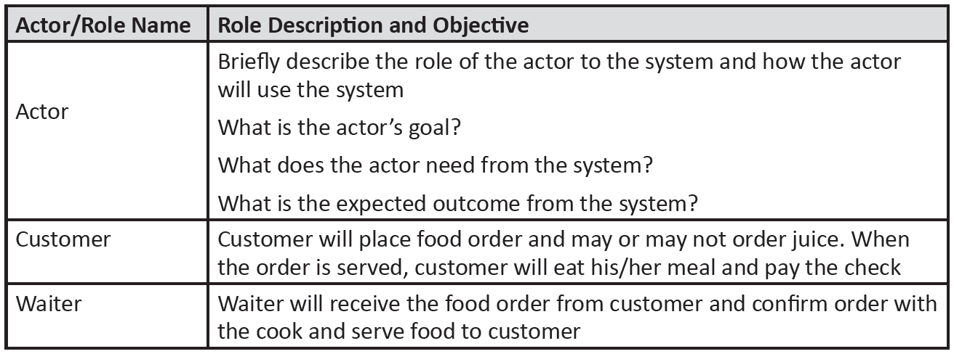
Define your use case actors

Slide 6
Create the use case basic flow
The basic flow represents the most important course of events or what happens most of the time, sometimes called a “happy day scenario” because it occurs when everything goes well (no errors). The benefits of creating the basic flow is that it once the norm is understood – which represents 70% of the system – it is easier to comprehend exceptions

Slide 7
Create the alternative flow
The alternative flow could be a variation or exception:
Variation: it is also referred to as an additional flow, which is another significant way to accomplish the same function that could be taken at this point (not necessarily error based). For example you can press (CTRL + S) to save a document or click on menu then click save. Another example, you can enter your username and password then hit ENTER or click on the LOGIN button
Exception: it describes anything that could go wrong (error), like what would happen if the user enters a wrong password? The system sends an error message

Slide 8
Special requirements
Special requirements describe any limitations to the function. For example, wire transfer limit is $500 or country limitations for international calls

Slide 9
Pre-conditions
Pre-conditions are the conditions that must be met before this use case can start. Such as, the user has been granted authority to access the system or prices must exist for the products being sold.

Slide 10
Post-conditions
This part is exactly how it sounds. What should happen when the use case ends?

Slide 11
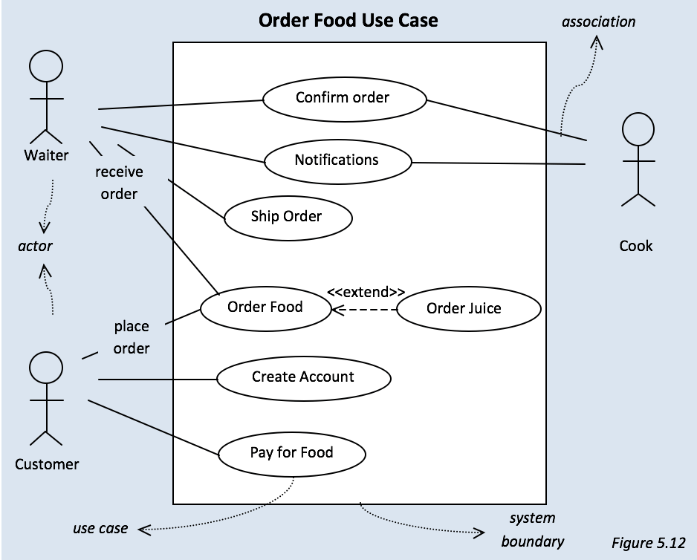
Create the use case diagram

